Slide 1
CARDIOCARE | PREVENTATIVE CARE ANALYTICS
CardioRisk Prediction
Model Selection Assignment — Analysis & Recommendation
Prepared by M. Bulah
Dataset: health_data.csv — 70,000 patient records, 14 fields
Source code & report: github.com/bulah16/C6-Project

Slide 2
OVERVIEW
What This Deck Covers
01
Problem & Business Objective
Why CardioCare needs a CVD risk model
02
Dataset & Methodology
70,000 records, cleaning, feature engineering
03
Exploratory Insights
What drives cardiovascular disease risk
04
Model Building & Tuning
Linear SVM vs. Decision Tree, GridSearchCV
05
Results & Recommendation
Final model choice and next steps
CardioRisk Prediction | M. Bulah
2

Slide 3
SECTION 1
Problem Statement & Business Objective
The Problem
The Objective
CardioCare wants to strengthen preventative care as cardiovascular disease (CVD) becomes more prevalent. Doctors’ consultation time is limited, so identifying at-risk patients early is both a clinical and operational priority.
Build a model that predicts CVD risk from routine check-up data, so CardioCare can:
Prioritise consultations for high-risk patients
Streamline screening for low-risk patients
Compare a Linear SVM and Decision Tree fairly
Tune and select the best-performing model
CardioRisk Prediction | M. Bulah
3

Slide 4
SECTION 2
Dataset Overview
70,000 patient records • 14 columns • target: cardio (CVD present / absent)
Field | Description | Type
age | Age (source: days → converted to years) | Numeric
gender | 0 = Female, 1 = Male | Categorical
height / weight | cm (→ metres) / kg | Numeric
ap_hi / ap_lo | Systolic / diastolic blood pressure (mmHg) | Numeric
cholesterol / gluc | 0 = normal, 1 = above, 2 = well above normal | Categorical
smoke / alco / active | Binary lifestyle indicators | Binary
cardio | Target: CVD present (1) or absent (0) | Target
CardioRisk Prediction | M. Bulah
4

Slide 5
SECTION 2
Methodology — The Analysis Pipeline
1
2
3
4
Data Understanding
Data Cleaning
EDA
Feature Engineering
70,000 × 14 loaded; identifiers dropped
Implausible rows removed (1.9%); units fixed
Univariate, correlation & bivariate analysis
BMI derived; scaling; encoding
5
6
7
8
Train–Test Split
Model Building
Hyperparameter Tuning
Evaluation & Selection
70/30 stratified, seed = 42
Linear SVM + Decision Tree
5-fold GridSearchCV, scored on recall
ROC-AUC, recall, cutoff sweep comparison
CardioRisk Prediction | M. Bulah
5

Slide 6
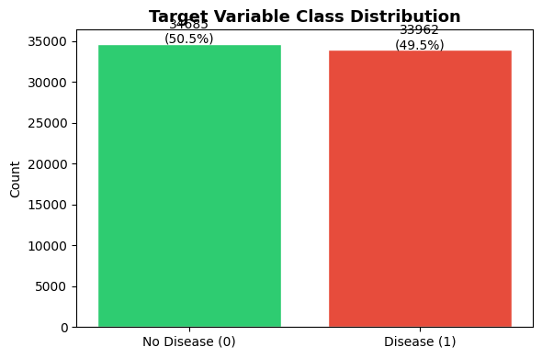
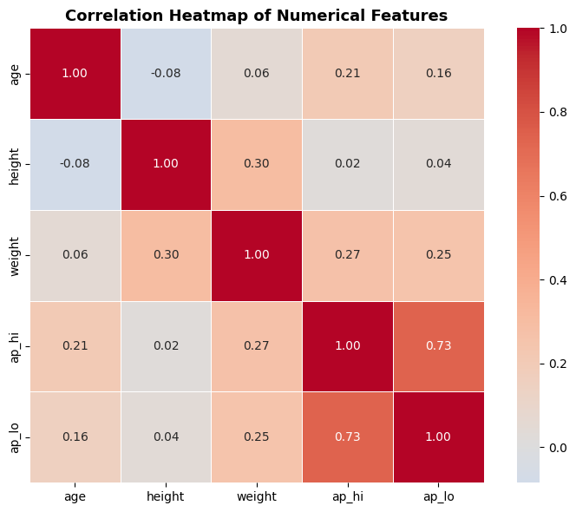
SECTION 3
Exploratory Data Analysis — Target & Correlation
Target is near-perfectly balanced (50.5% / 49.5%) — no resampling required.
Blood pressure fields correlate strongly with each other (r = 0.734).
CardioRisk Prediction | M. Bulah
6

Slide 7
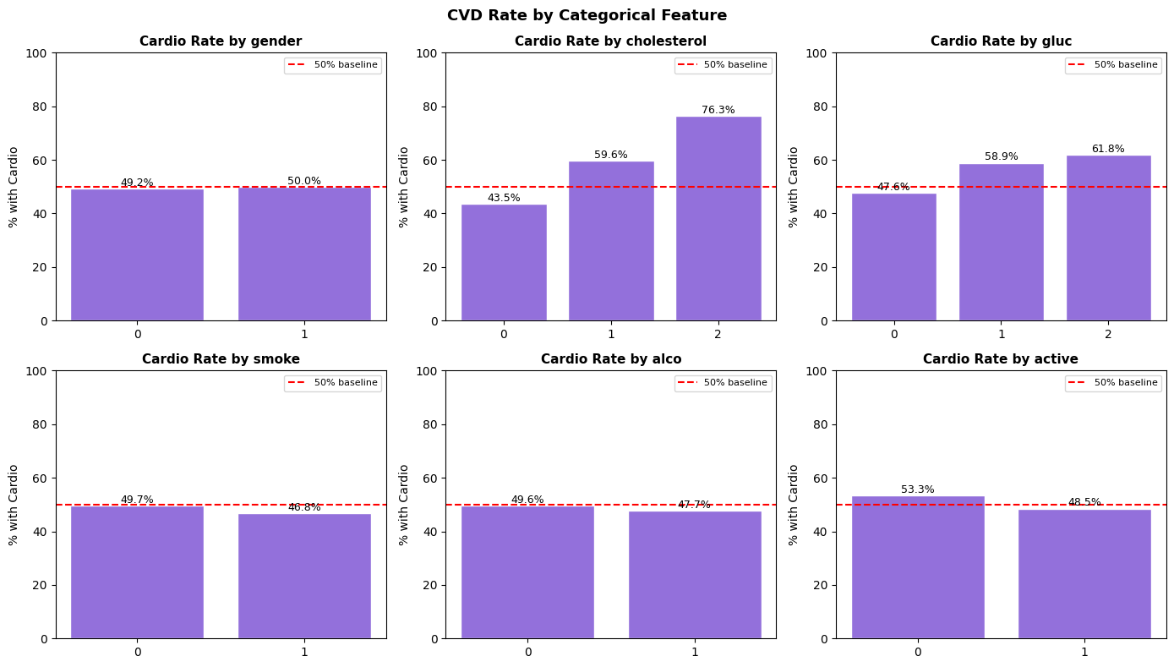
SECTION 3
What Drives CVD Risk?
76.3%
CVD rate at "well above normal" cholesterol vs. 43.5% at normal — a 32.8-point spread.
Weak signal
Gender, smoking & alcohol sit within a few points of the 49.5% base rate.
Counter-intuitive
Smokers & drinkers show slightly lower CVD rates — likely confounding, not protection.
CardioRisk Prediction | M. Bulah
7

Slide 8
SECTION 4
Two Models, Head-to-Head
Linear SVM
Decision Tree (Baseline)
Decision Tree (Tuned)
kernel = linear, C = 1.0
Trained on 15,000-row subsample
(SVC is O(n²) — full 48k set impractical)
Cutoff = 0.40
Unconstrained depth
Severe overfitting: train acc. ≈ 1.00
vs. test acc. 0.634
Motivates hyperparameter tuning
5-fold GridSearchCV, scored on recall
max_depth = 10, min_samples_leaf = 20
Trained on FULL 48,052-row set
Cutoff = 0.40
CardioRisk Prediction | M. Bulah
8

Slide 9
SECTION 5
Test-Set Performance — All Three Candidates
The unconstrained baseline collapses on unseen data; tuning recovers performance and gives the highest recall of all three.
CardioRisk Prediction | M. Bulah
9

Slide 10
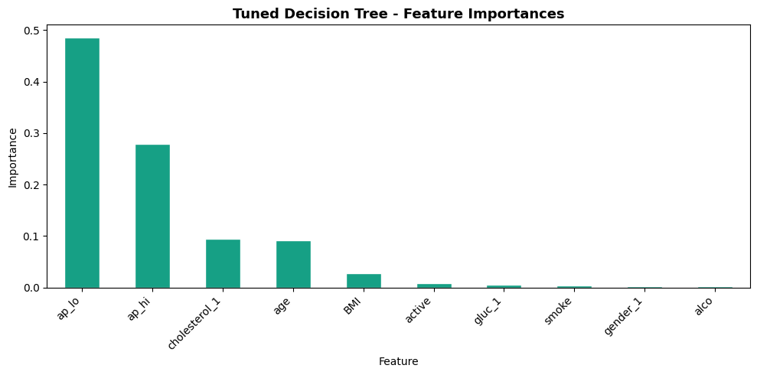
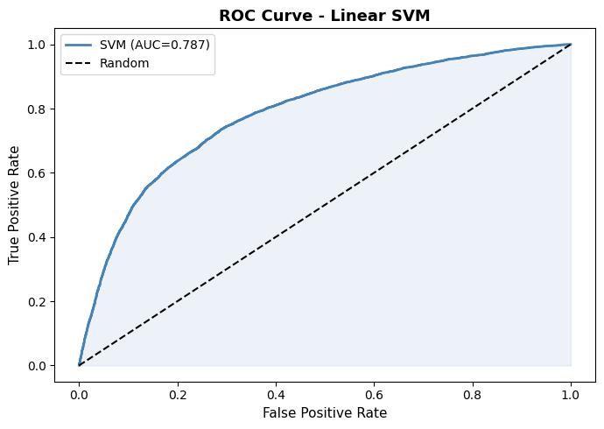
SECTION 5
What the Winning Model Relies On
ap_lo (48.6%) + ap_hi (27.9%) drive 76.5% of the Tuned Decision Tree’s decisions.
Linear SVM ROC curve — test ROC-AUC 0.787, close to the tuned tree’s 0.781.
CardioRisk Prediction | M. Bulah
10

Slide 11
ASSIGNMENT Q&A
Q1 & Q2 — Insights & Predictors
Q1. Health-metric relationships with CVD?
Q2. Strongest predictors? Any surprises?
Blood pressure: clearest numerical separator between CVD / non-CVD
Cholesterol: 43.5% → 76.3% CVD rate as level rises
Glucose: smaller but consistent gradient (47.6% → 61.8%)
Gender, smoking, alcohol: weak standalone predictors
ap_lo + ap_hi = 76.5% of the tuned model’s decisions; cholesterol and age make up most of the rest.
Surprising finding
Smokers (46.8%) and drinkers (47.7%) show slightly lower CVD rates than non-users — the opposite of clinical evidence, most likely confounding in the sample rather than a real protective effect.
CardioRisk Prediction | M. Bulah
11

Slide 12
ASSIGNMENT Q&A
Q3 & Q4 — Model Effectiveness & Integration
Q3. How effectively can ML models identify at-risk individuals?
Regularised models (SVM, Tuned DT) both reach ROC-AUC ≈ 0.78–0.79 — well above the 0.50 baseline
The unconstrained baseline shows how badly an untuned model performs on unseen data (AUC 0.635)
None is precise enough to stand alone — all are best used as a triage aid, not a diagnostic replacement
Q4. Integrating the model into CardioCare’s workflow?
Deploy Tuned Decision Tree as a pre-consultation screening filter; flag patients ≥ 0.40 probability
Pair every score with its top contributing factors so clinicians can sanity-check it
Keep a secondary clinical review step — roughly 20% of true CVD cases may still be missed
Retrain periodically; invest in richer features (ECG, family history, HbA1c) to raise the AUC ceiling
CardioRisk Prediction | M. Bulah
12

Slide 13
SECTION 6
Key Assumptions Made
Data & Cleaning
Feature Engineering
Modelling
age recorded in days → converted to years
height in cm → converted to metres for BMI
Implausible BP/height/weight rows removed, not imputed
No missing-value imputation needed (zero nulls)
"Above normal" & "well above normal" merged to "elevated"
BMI replaces height & weight (r = 0.856 with weight)
smoke/alco/active kept as-is; only gender/chol./gluc dummy-encoded
Scaler fit on train only, applied to test
SVM trained on a 15,000-row random subsample (seed 42)
0.40 cutoff used throughout — favours recall over precision
GridSearchCV scored on recall, not accuracy/AUC
RBF-kernel SVM / third model not pursued (scope & compute)
CardioRisk Prediction | M. Bulah
13

Slide 14
RECOMMENDATION
Deploy the Tuned Decision Tree
as CardioCare’s primary CVD screening model
0.802
0.781
0.011
48,052
Test Recall (highest of 3)
Test ROC-AUC
Train–Test Gap (well controlled)
Rows trained on (full set)
Highest test recall — catches the largest share of true CVD-positive patients
ROC-AUC close to the Linear SVM’s, but trained on the full 48,052-row set, not a subsample
Overfitting well controlled (train–test gap of just 0.011)
Remains interpretable — clinicians can review why a patient was flagged
Leading features (blood pressure, cholesterol) are clinically meaningful and actionable
CardioRisk Prediction | M. Bulah
14

Slide 15
Thank You
CardioRisk Prediction — M. Bulah
Full notebook, dataset and report available at:
github.com/bulah16/C6-Project

